Slide 1
SERVANT KING

Slide 2
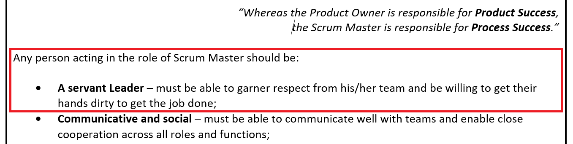
“The servant-leader is servant first” Robert K. Greenleaf (Servant Leadership founder) 1970
Agile SCRUM Roles and Responsibilities 2017, Connect

Slide 3
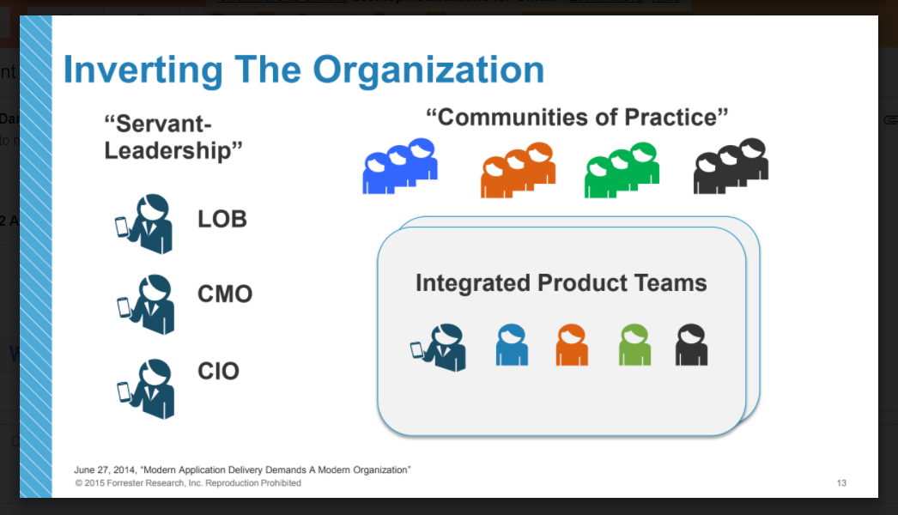
“The servant-leader is servant first” Robert K. Greenleaf (Servant Leadership founder) 1970
Diego Lo Giudice Modern Application Delivery, Connect

Slide 4
“The servant-leader is servant first” Robert K. Greenleaf (Servant Leadership founder) 1970
CHARACTERISTICS OF A SERVANT LEADER
Humble
Performs duties for others (getting hands dirty)
Focuses on the needs of others
Is an unblocker

Slide 5
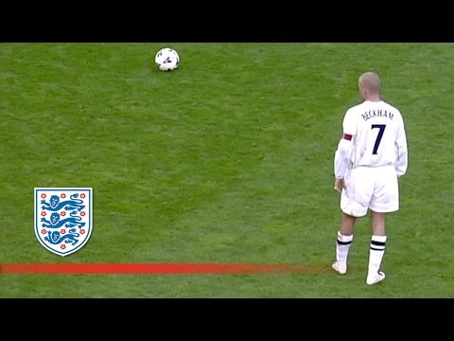
“The servant-leader is servant first” Robert K. Greenleaf (Servant Leadership founder) 1970
WORK, HOME, PLAY
David Beckham v Greece 2001

Slide 6
“whoever would be great among you must be your servant” Jesus, Matthew 20:26
Nothing new under the sun

Slide 7
“whoever would be great among you must be your servant” Jesus, Matthew 20:26
CHARACTERISTICS OF A SERVANT LEADER
Humble
Performs duties for others (getting hands dirty)
Focuses on the needs of others
Is an unblocker

Slide 8
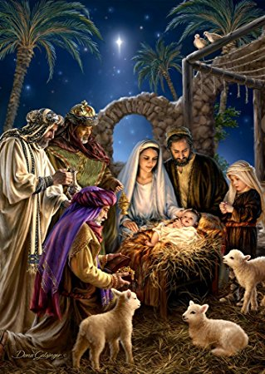
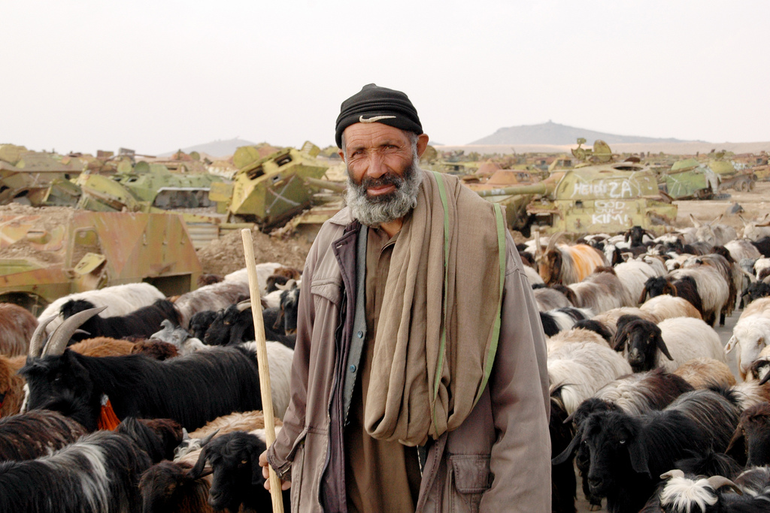
“whoever would be great among you must be your servant” Jesus, Matthew 20:26
HUMBLE

Slide 9
“whoever would be great among you must be your servant” Jesus, Matthew 20:26
CHARACTERISTICS OF A SERVANT LEADER
Humble
Performs duties for others (getting hands dirty)
Focuses on the needs of others
Is an unblocker

Slide 10
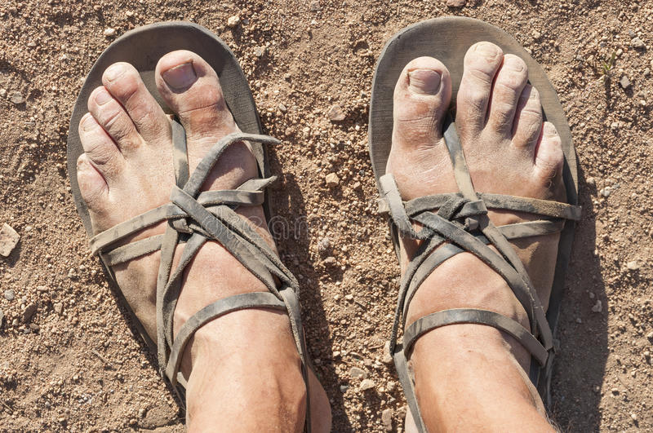
“whoever would be great among you must be your servant” Jesus, Matthew 20:26
PERFORMS DUTIES FOR OTHERS (getting hands dirty)

Slide 11
“whoever would be great among you must be your servant” Jesus, Matthew 20:26
CHARACTERISTICS OF A SERVANT LEADER
Humble
Performs duties for others (getting hands dirty)
Focuses on the needs of others
Is an unblocker

Slide 12


“whoever would be great among you must be your servant” Jesus, Matthew 20:26
UNBLOCKER
FOCUSES ON THE NEEDS OF OTHERS

Slide 13
The servant Queen
She served as a truck mechanic in 1945 as part of the war effort, she can rebuild the 6 cylinder Austin K2 ambulance engine
The Queen chose to live on rations during the war
In 2016 the 90 year old queen held 341 engagements, more than the Duke and Duchess of Cambridge and Prince Harry combined
At 90 she still works over 40 hours a week
“There are no reliable recorded incidents of the Queen losing her temper, using bad language or refusing to carry out a duty expected of her.” Andrew Marr (political commentator)
https://www.youtube.com/watch?v=YUPsMTqKWdM&t=4m47s

